Slide 1
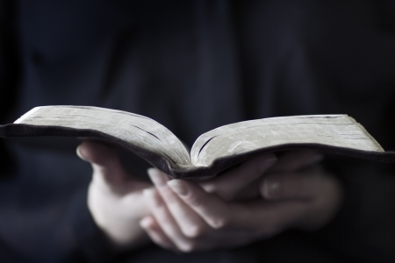
Psalm 22

Slide 2
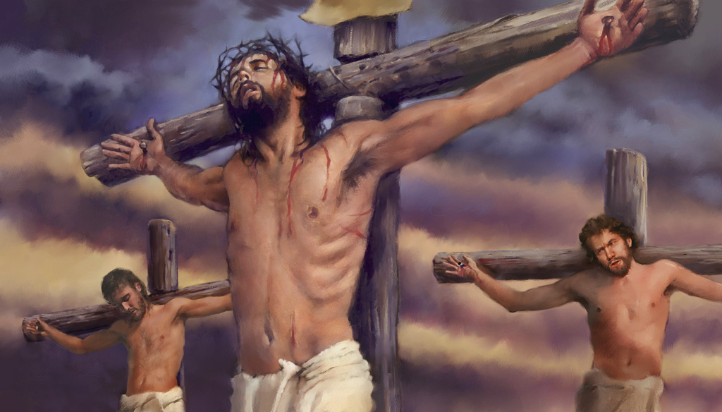
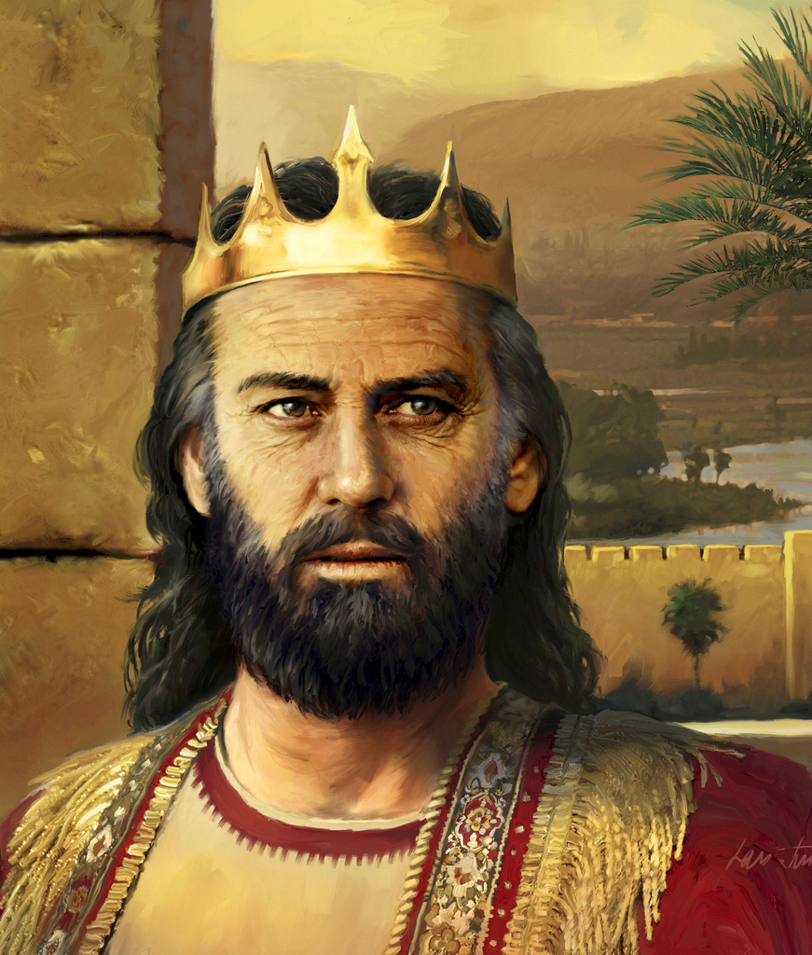
David wrote this psalm, telling about a time when he was surrounded by his enemies and facing death. Feeling forsaken, he pleaded with God to deliver him. His prayer was answered and he declared this to the world.
1000 years later, Jesus Christ felt the same way as He faced a terrible death, and He became the fulfillment of these verses. Read about this event in Mark 15.

Slide 3
“My God, my God, why hast Thou forsaken me?”

Slide 4
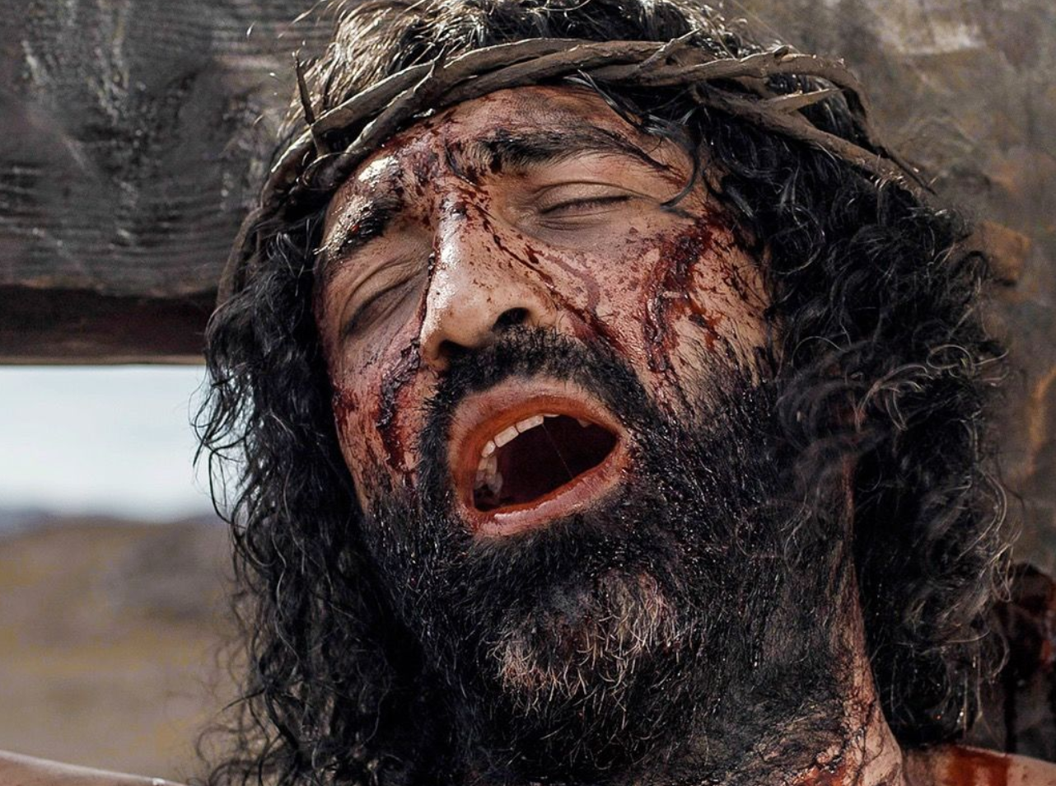
Like the psalmist, As Jesus was hanging on the cross, what was His cry (Mark 15:34)?”

Slide 5
“Far from my deliverance are the words of my groaning. O my God, I cry by day, but Thou dost not answer; and by night, but I have no rest. Yet Thou art holy, O Thou who art enthroned upon the praises of Israel. In Thee our fathers trusted; they trusted, and Thou didst deliver them. To Thee they cried out, and were delivered; In Thee they trusted, and were not disappointed.”

Slide 6
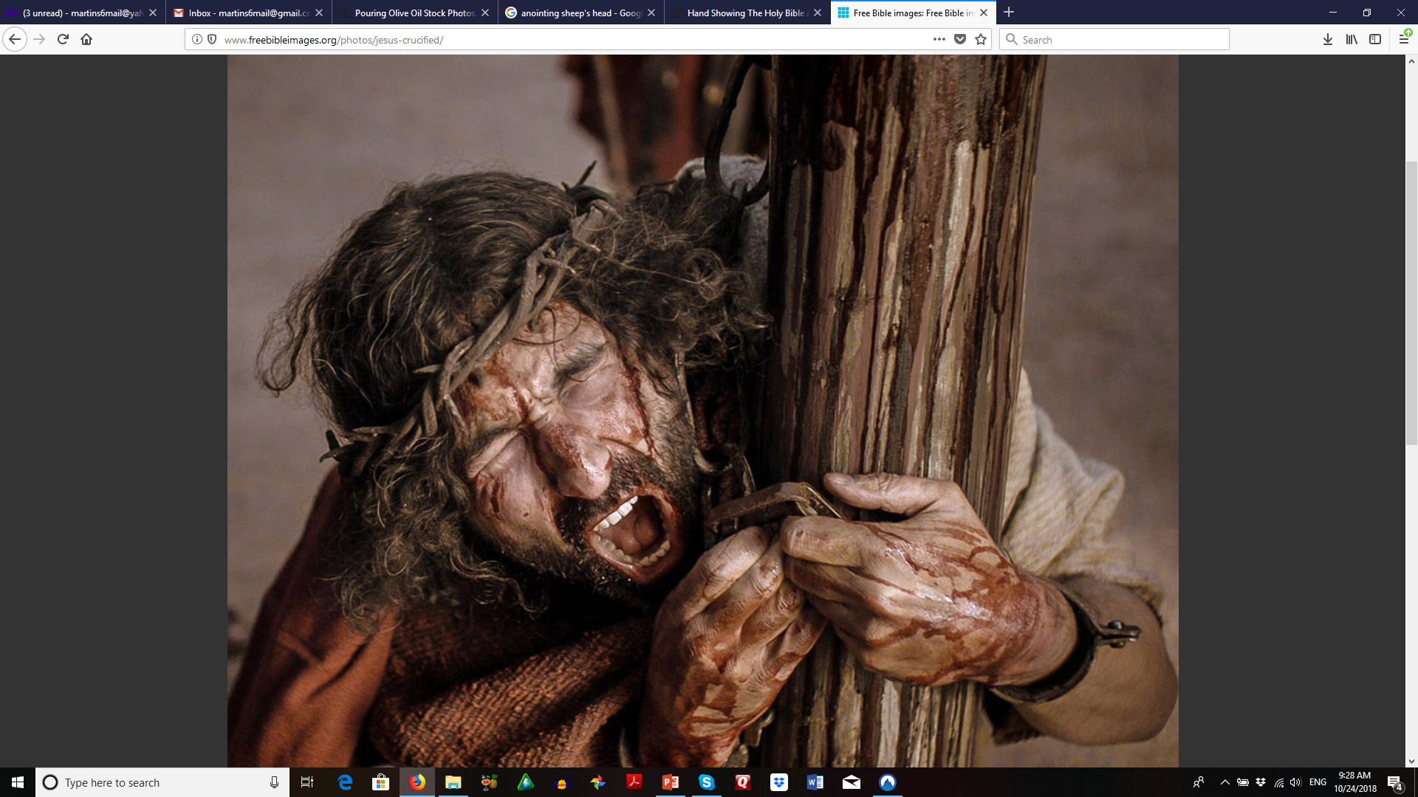
What were some of the things Jesus experienced at the hands of His enemies?
✓Matthew 26:57-68
✓Matthew 27:11-26

Slide 7
“But I am a worm, and not a man, a reproach of men, and despised by the people. All who see me sneer at me; they separate with the lip, they wag the head, saying, ‘Commit yourself to the Lord; let Him deliver him;
let Him rescue him, because He delights in him.’”

Slide 8
As Jesus hung on the cross, what did he experience from the people? (Matthew 27:39-44)
The book of Isaiah was written 700 years before this event. Read Isaiah 53:1-3 and tell how these verses compare to the verses you just read in Matthew 27 and Psalm 22

Slide 9
“Yet Thou art He who didst bring me forth from the womb; Thou didst make me trust when upon my mother’s breasts. Upon Thee I was cast from birth; Thou hast been my God from my mother’s womb.”

Slide 10
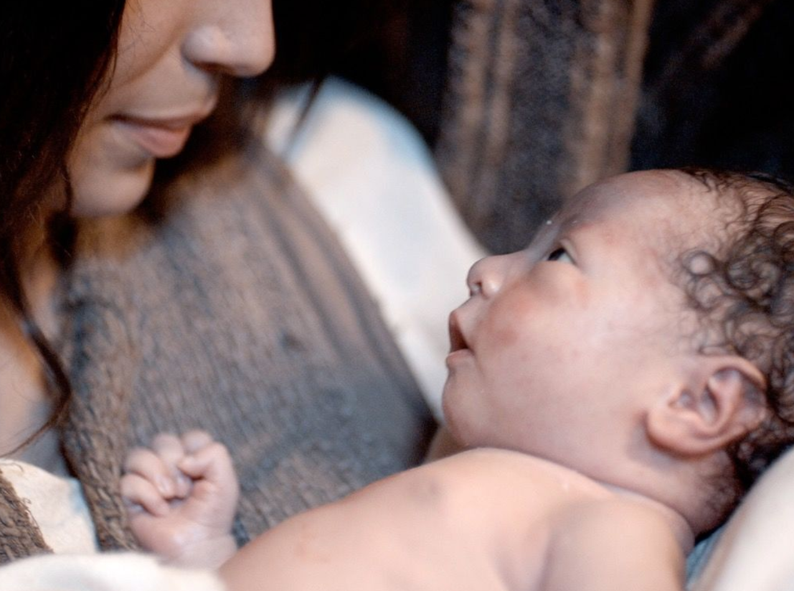
Read Matthew 1:18-25 to discover the purpose for Jesus’ birth.

Slide 11
“Be not far from me, for trouble is near;
for there is none to help. Many bulls have surrounded me; strong bulls of Bashan have encircled me. They open wide their mouth at me, as a ravening and a roaring lion.”

Slide 12
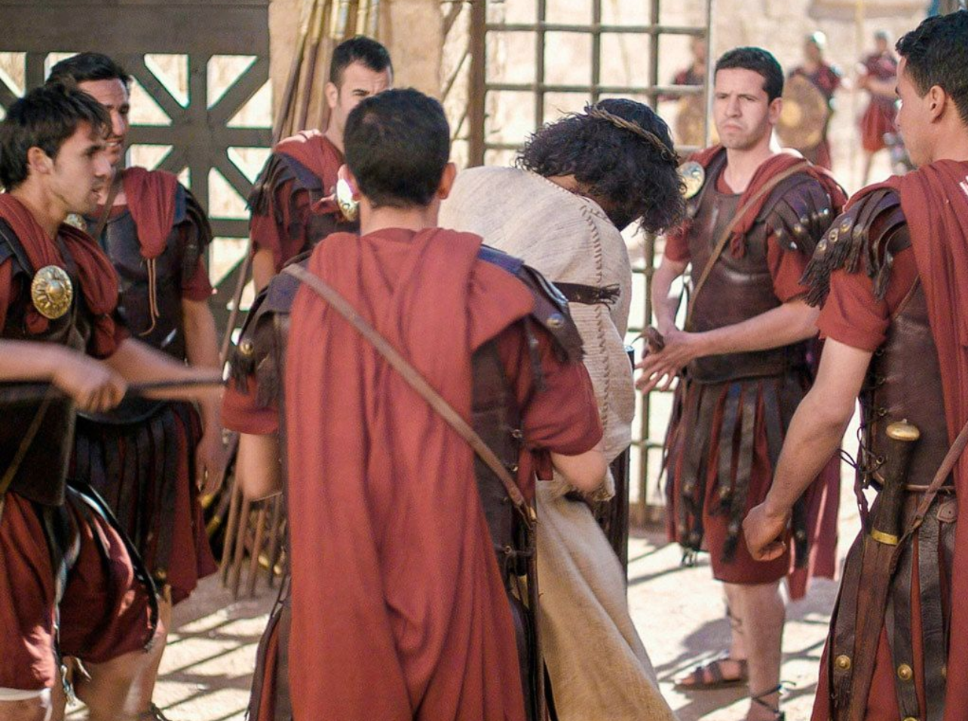
How did Jesus suffer at the hands of the Roman soldiers who gathered around Him (Matthew 27:27-31)?

Slide 13
“I am poured out like water, and all my bones are out of joint; my heart is like wax; it is melted within me. My strength is dried up like a potsherd, and my tongue cleaves to my jaws; and Thou dost lay me in the dust of death.”

Slide 14
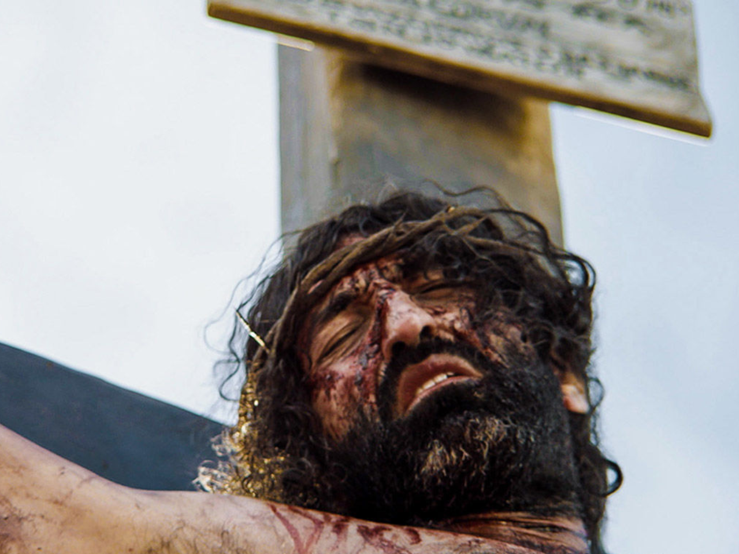
According to these verses, what does Jesus say about His own death?
✓Matthew 26:53
✓John 10:11-18

Slide 15
“For dogs have surrounded me; a band of evildoers has encompassed me; they pierced my hands and my feet. I can count all my bones. They look, they stare at me.”

Slide 16
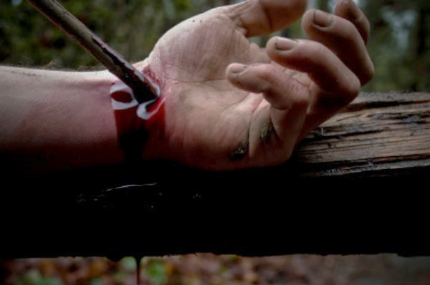
According to these verses, why was Jesus pierced?
✓Isaiah 53:4-7, 10-12
✓1 Corinthians 15:3,4
✓2 Corinthians 5:18-21

Slide 17
“They divide my garments among them, and for my clothing they cast lots.”

Slide 18
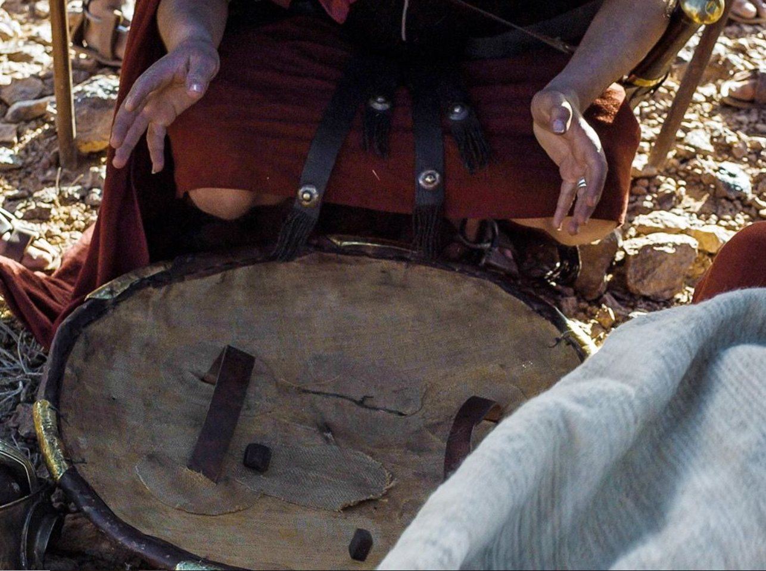
What did they do with Christ’s clothing? (John 19:23-24)

Slide 19
“But Thou, O Lord, be not far off; O Thou my help, hasten to my assistance. Deliver my soul from the sword, my only life from the power of the dog. Save me from the lion’s mouth; and from the horns of the wild oxen Thou dost answer me.”
“From Thee comes my praise in the great assembly; I shall pay my vows before those who fear Him. The afflicted shall eat and be satisfied; those who seek Him will praise the Lord. Let your heart live forever!”

Slide 20
“I will tell of Thy name to my brethren; in the midst of the assembly I will praise Thee. You who fear the Lord, praise him; all you descendants of Jacob, glorify Him, and stand in awe of Him, all you descendants of Israel. For He has not despised nor abhorred the affliction of the afflicted; neither has He hidden His face from him; but when he cried to Him for help, He heard.”

Slide 21
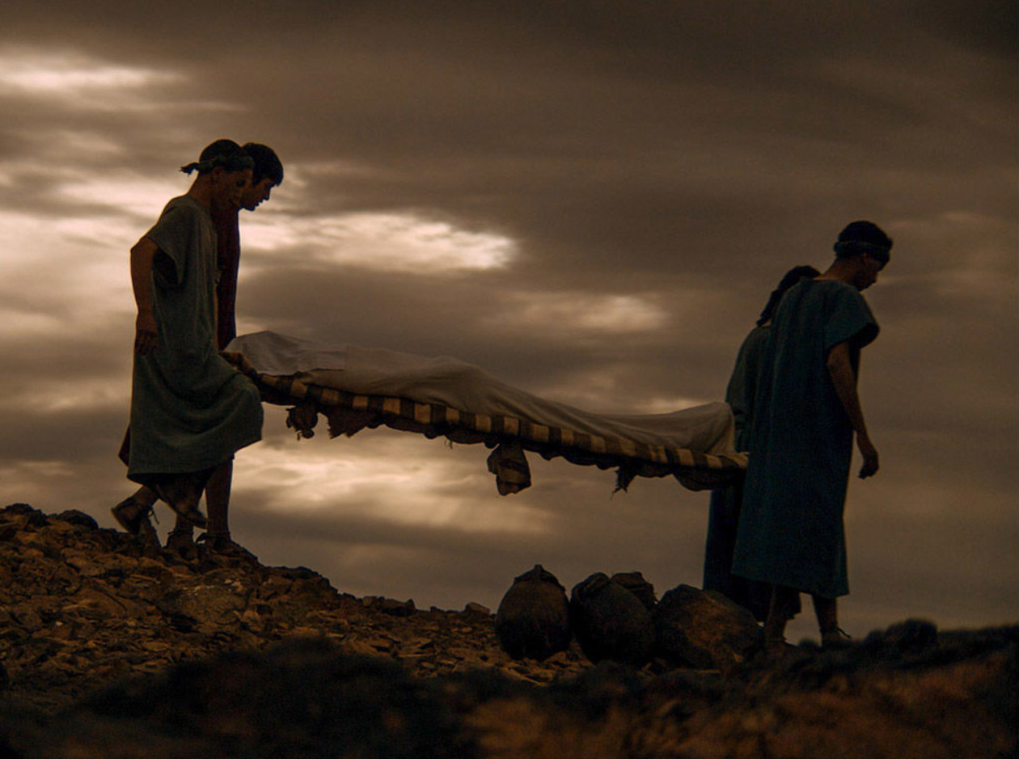
Unlike the psalmist, God did not deliver Jesus from death when He prayed. Why (Hebrews 5:7-9)?

Slide 22
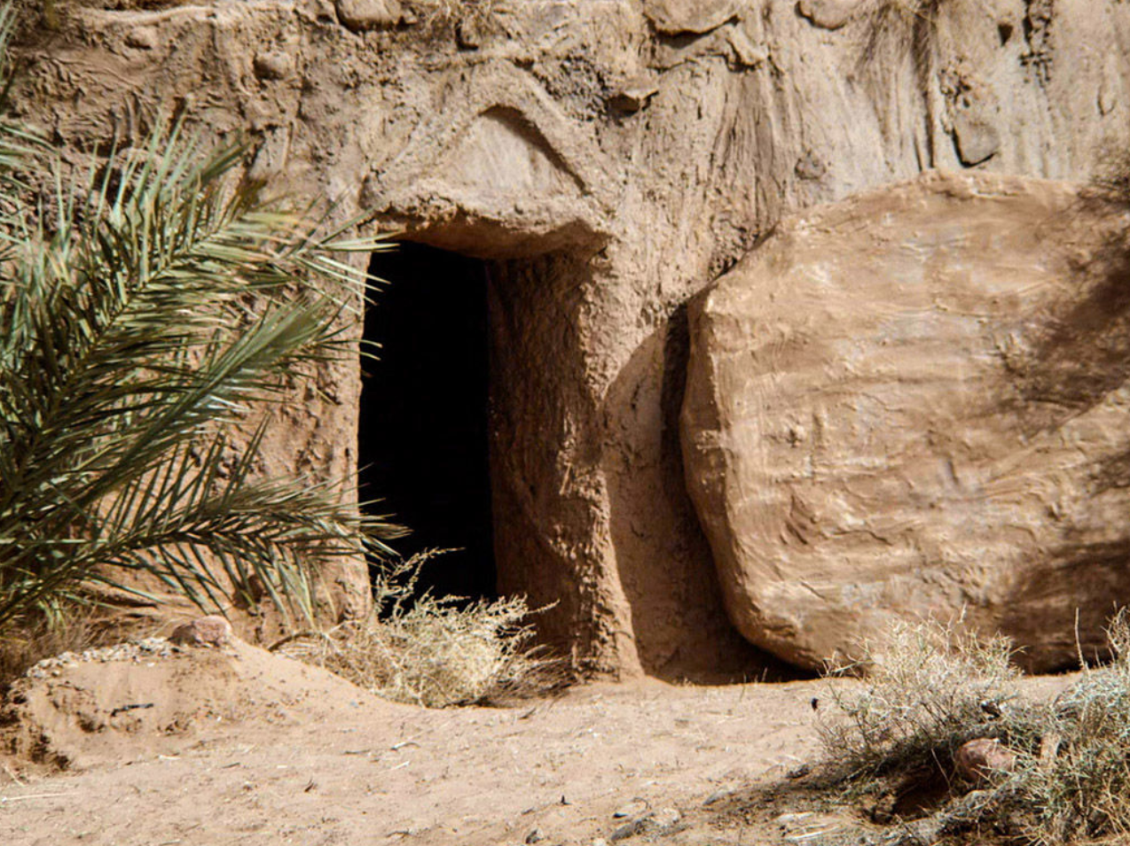
Though God did not spare Jesus from experiencing death, how did He deliver Him (Matthew 28:1-10)?

Slide 23
“All the ends of the earth will remember and turn to the Lord, and all the families of the nations will worship before Thee. For the kingdom is the Lord’s, and He rules over the nations.
All the prosperous of the earth will eat and worship, all those who go down to the dust will bow before Him, even he who cannot keep his soul alive.
Posterity will serve Him; it will be told of the Lord to the coming generation. They will come and will declare His righteousness
to a people who will be born, that He has performed it.”

Slide 24
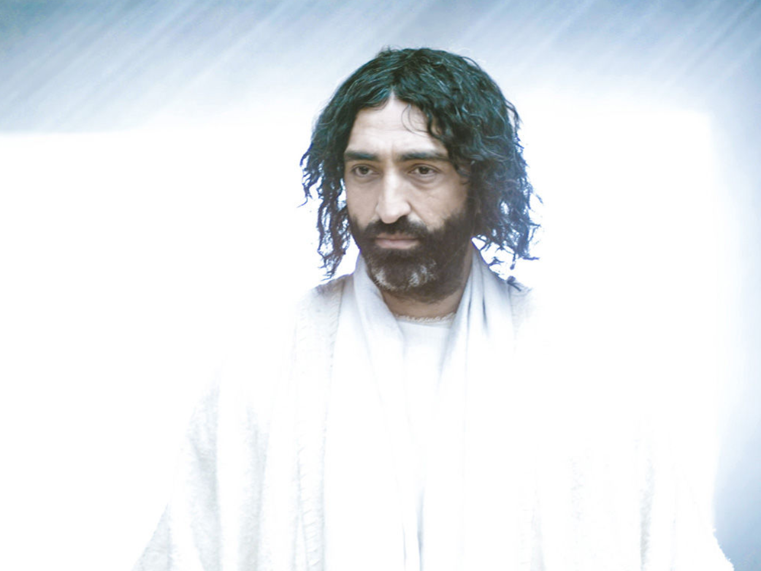
According to Philippians 2:5-11, who will bow before the Lord Jesus some day?
Psalm 22 was written around the 10th century B.C. Have these verses come to pass?
Knowing that God’s Word has been proven true by the test of time, how does that make you feel about God’s promises yet to be fulfilled?

Slide 25
We want to thank the following for their help in providing pictures for this presentation: 123rf.com Goodsalt.com Freebibleimages.org

